Slide 1
Learner Engagement
in eLearning
Georgianna Laws
Instructional Designer
Augusta University (GRU)
Notes:
Thank you Veronica and goooood Wednesday afternoon everoyne! - 1: How are you doing today? How are you enjoying the conference so far? - My name/institution/role/clients - 2: What institution do you hail from and what is your role there?

Slide 2
Your Own Experiences
eLearning Engagement
Notes:
1: In a few words, please tell me what was the most unique/memorable format in which you have ever taken a DL course? - 2: Likes about engagement in that course? - 3: Dislikes?

Slide 3
Themes in the Literature
Notes:
Themes from the literature may echo the experiences that participants just described

Slide 4
https://www.qmprogram.org/qmresources/research/
Notes:
Standard 5: Course Activities and Learner Interaction – or key word such as “engagement”

Slide 5
Self-Paced
Engagement Types
Correspondence
“True”
Distance Learning
Notes:
Self-Paced Tips: Solid systematic design; with built-in, just-in-time feedback; game like – Berlitz or Rosetta Stone language course
Correspondence: Few still use this method; a more updated version is live, private teaching/tutoring
Distance: Standard in the academic arena
-- all valid, all have their unique uses
-- manage expectations: don’t expect S-T in self paced & expect S-T in distance learning

Slide 6
Distance Learning
Notes:
S-C, S-T, S-S

Slide 7
Student – Content
Course orientation
Learning Activities
Notes:
Pitfall: if you leave the S alone with the C 100% of the time → you’re doing correspondence
Orientation: interactive syllabus + scavenger hunt (or quiz)
Learning activities: active (e.g., papers, projects) or reflective (learning journals)

Slide 8
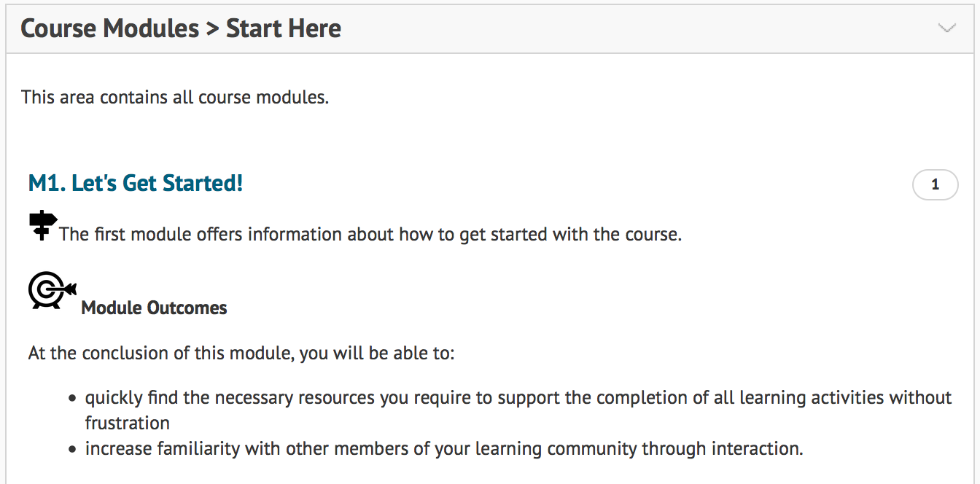
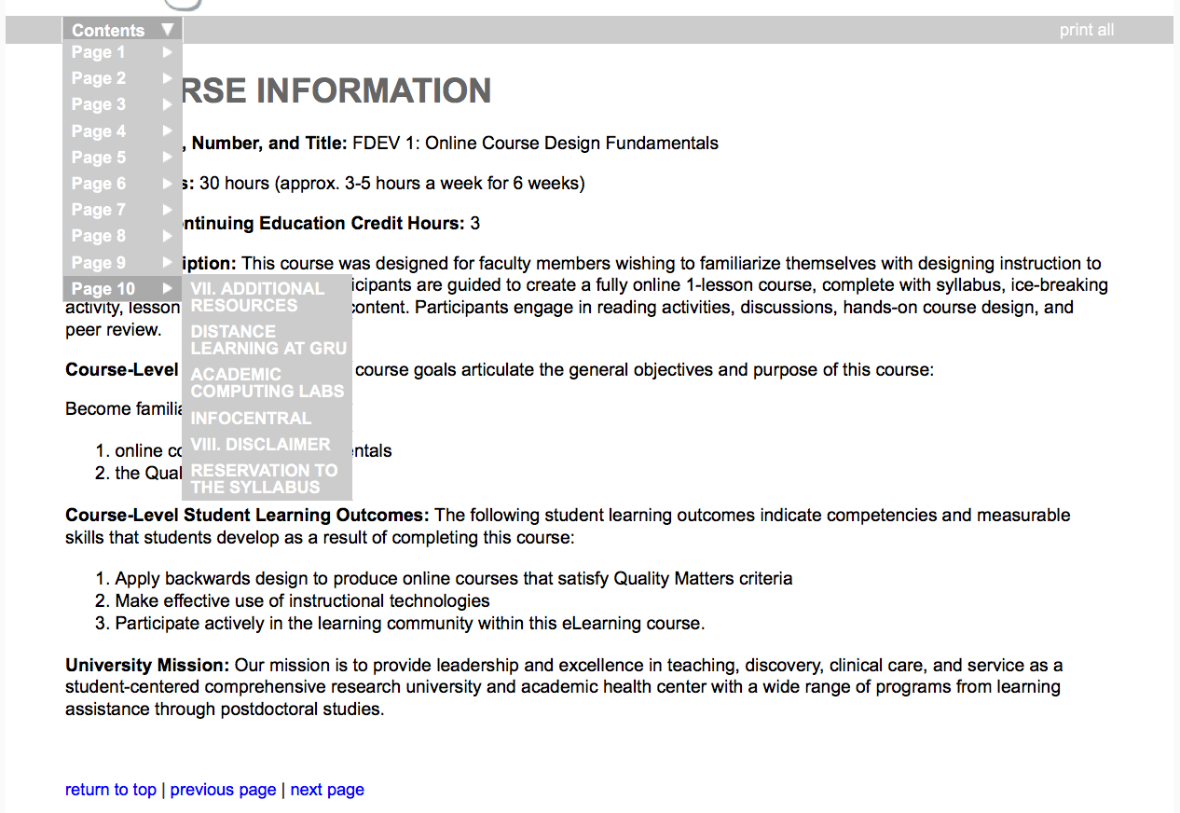
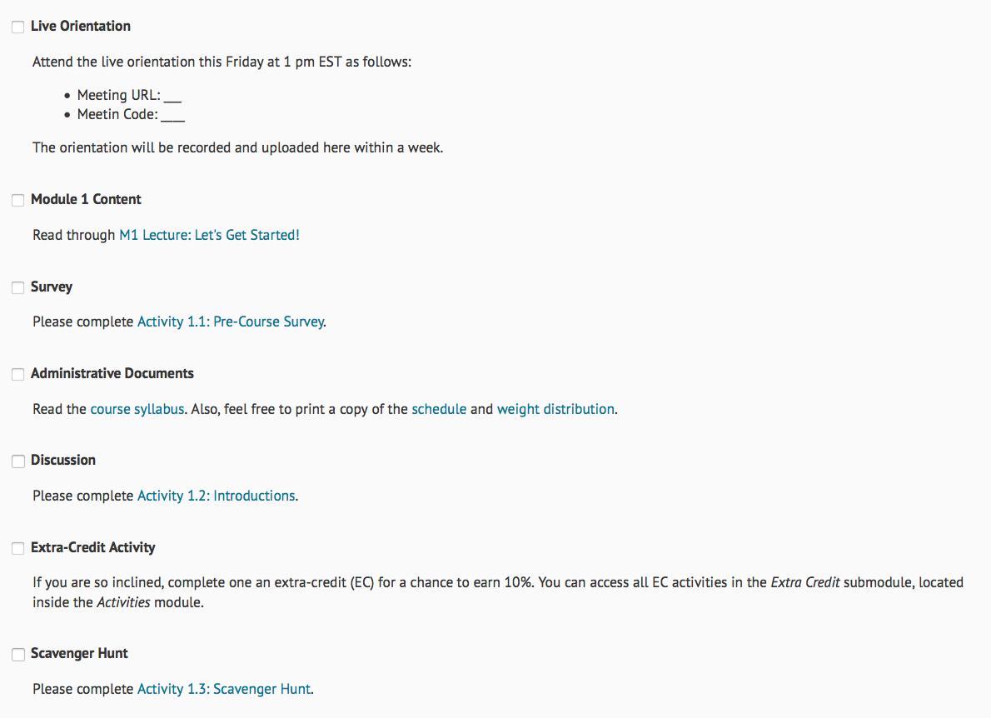
Implementation Examples

Slide 9
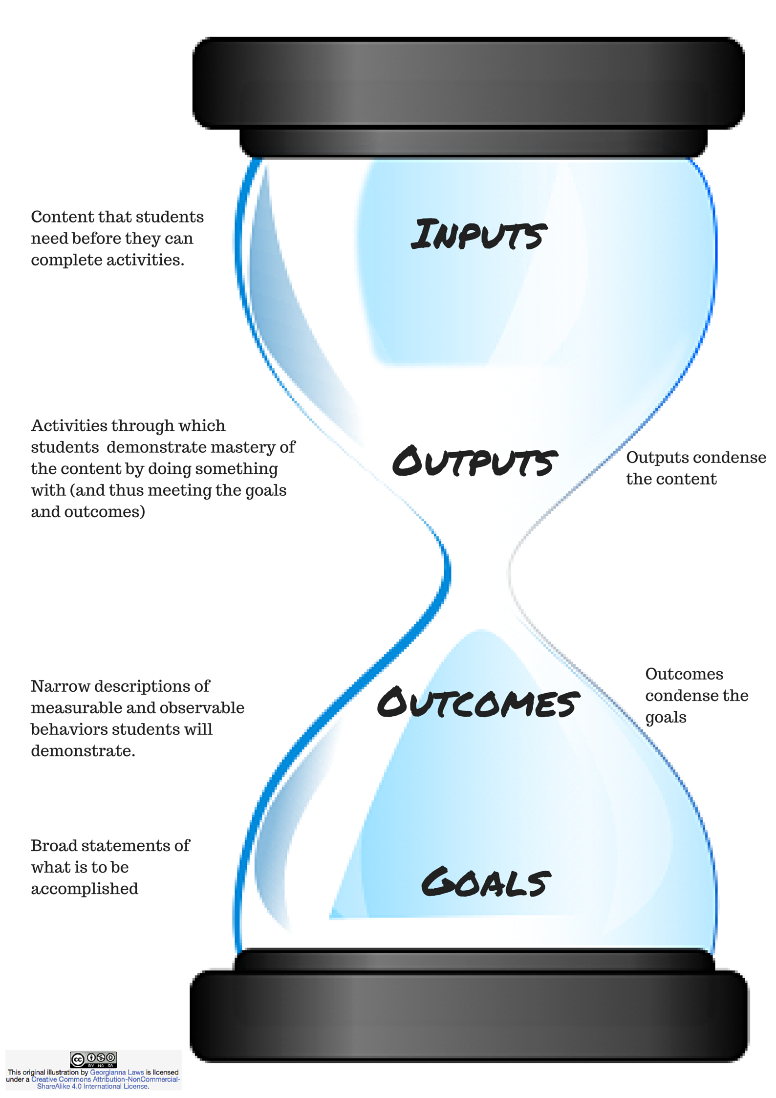
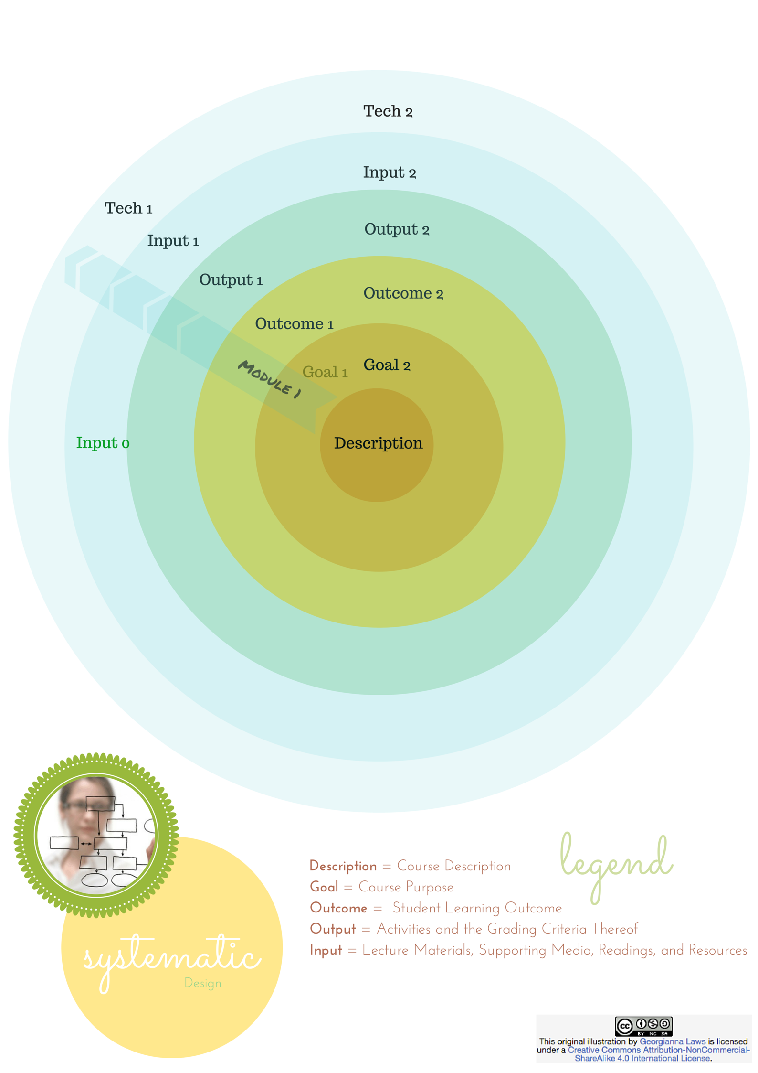
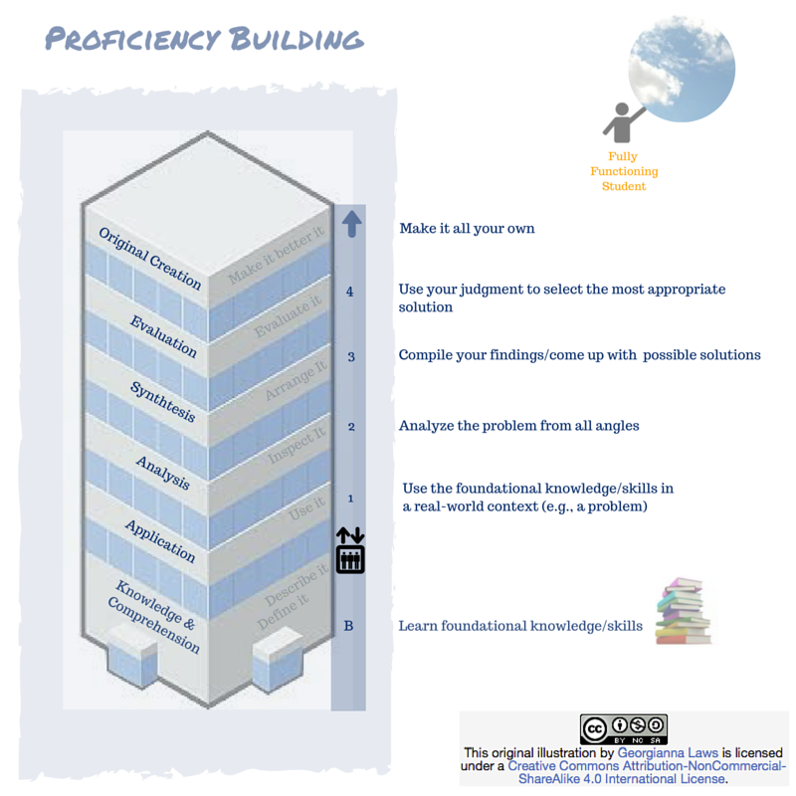
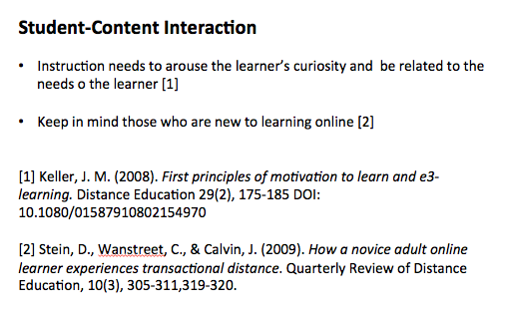
Literature & Theoretical Underpinnings
Notes:
Can you think of an eLearning course in which the only thing that students need to get out of the course is knowledge?
Pitfalls to avoid:
Not seeing the forest for the trees -- keeping students in the basement → be sure to get learners to do something with the content
Overezeal -- aiming to take the to the roof when that is outside the scope of the module/course/program → decide how far in the building you need to take the learners in order to meet the learning outcomes

Slide 10
Notes:
$33 on Amazon → 2nd edition to be released next month

Slide 11
Student – Teacher
Office Hours
Getting Started
Before
Clear Instructions
Grading Rubrics
During
Timely Feedback
Notes:
The three major components of teaching presence are:
instructional design → course materials
building understanding → answer questions, confirm understanding, reinforce key concepts
direct instruction/feedback → foster student engagement, encourage collaboration, focus discussions, share personal meaning

Slide 12
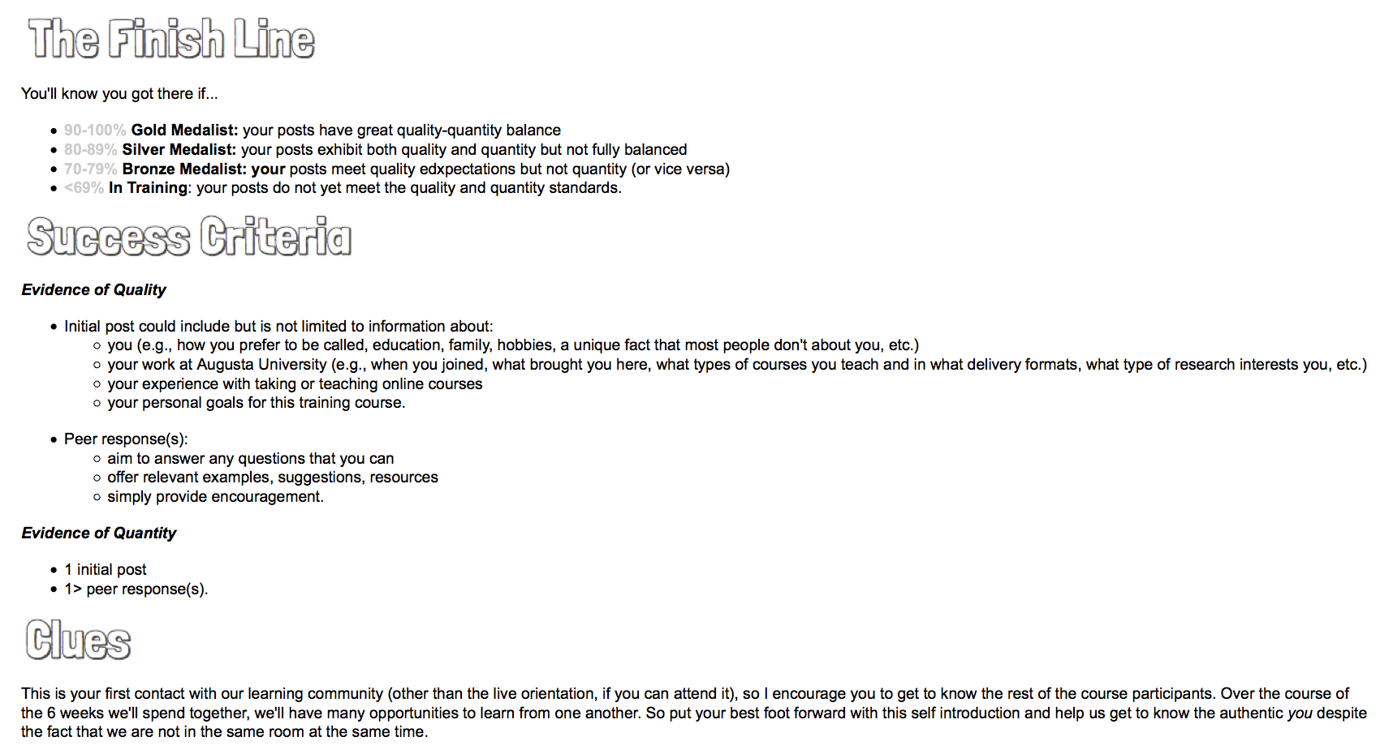
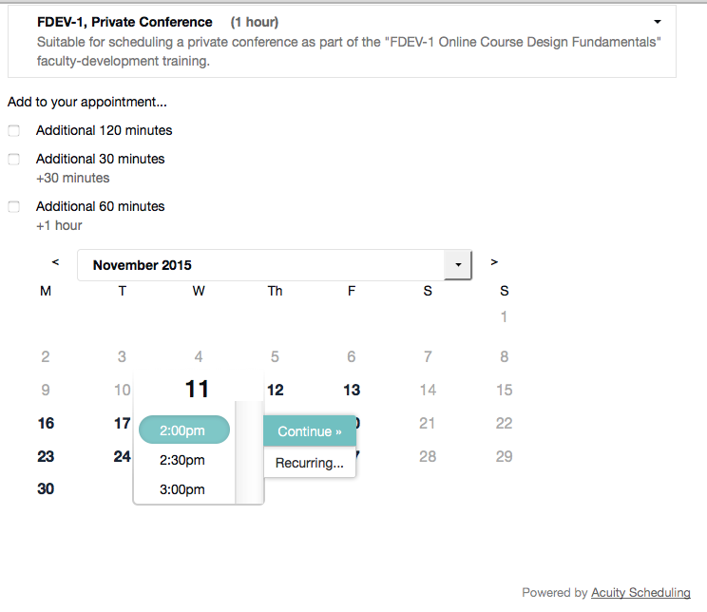
Implementation Examples
Notes:
Pitfalls to avoid:
skip the performance gap analysis → need to determine exactly what students need to learn/unlearn before being able to perform as needed;
skip the design → content needs to bridge the gap & align with measurable learning outcomes+learning activities and provide no more/less than what the students need (choose an appropriate cognitive load);
ignoring accessibility → applying universal design ensure that students of any ability (and language proficiency) can take the course;
ignore shelf life → you want to get the longest possible shelf life out of your hard work

Slide 13
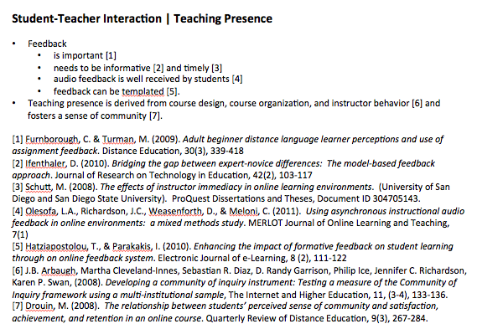
Literature & Theoretical Underpinnings

Slide 14
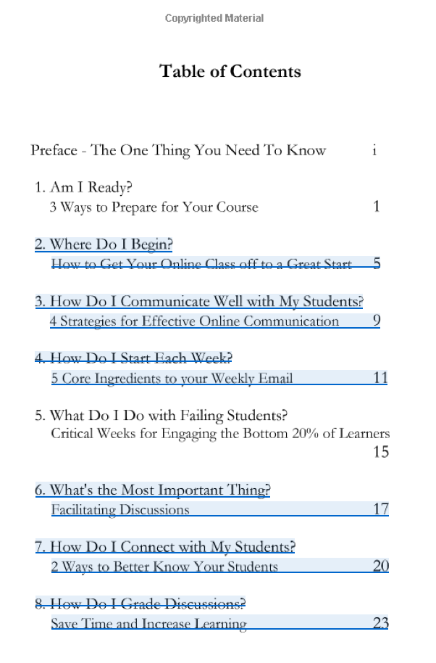
Notes:
$8 on Amazon

Slide 15
Student – Student
Getting Started
Learning Activities
Notes:
Learning community
Peer collaboration
If working with teams, provide team resources, including:
- Team charter: set the group’s goals, take inventory of skills, allocate resources, have plan B, etc.
A learning team log– to keep track of meetings the team has
Faculty role: guide in team formation, review team logs/charter, outline team tasks, evaluate team work, coach teams in dealing with internal conflict, enable students to reflect on the learning experience
Cap teams at 6 (3-6 ideal)

Slide 16
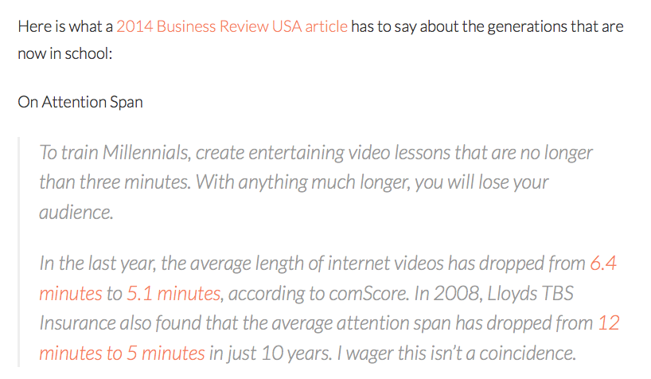
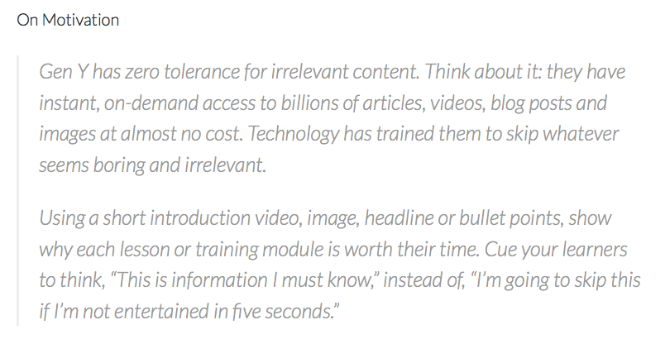
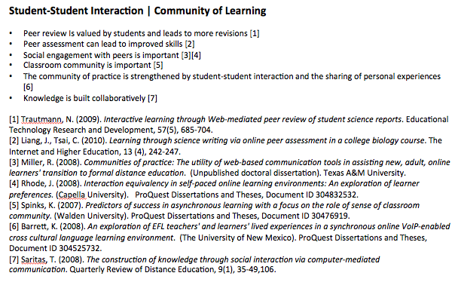
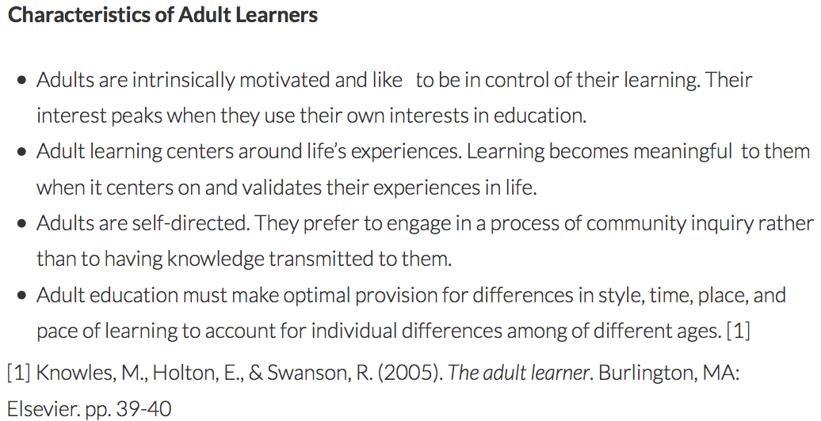
Literature & Theoretical Underpinnings

Slide 17
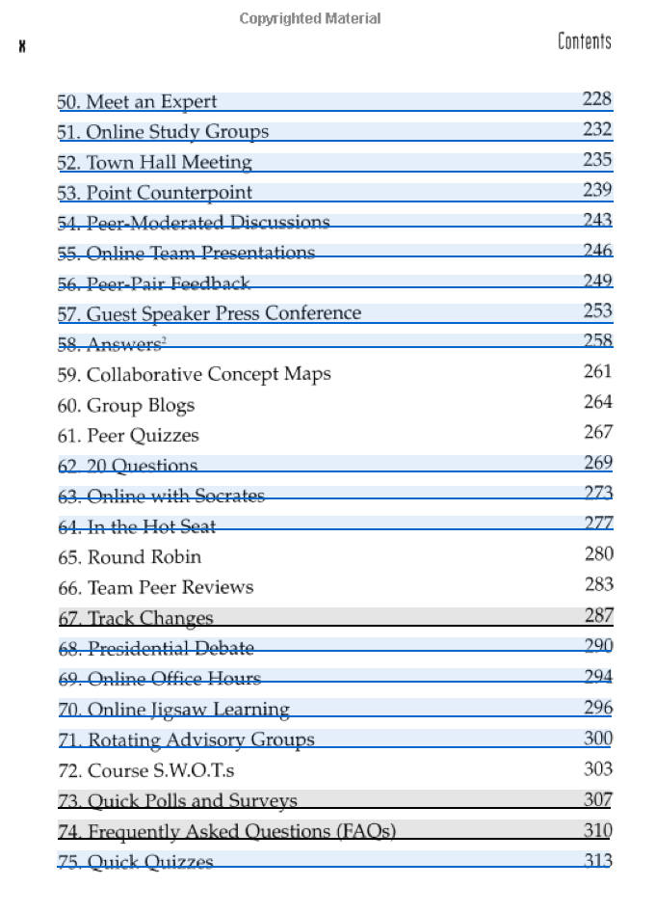
Notes:
$6 – 90 on Amazon

Slide 18
Notes:
1: Any sparks? In a few words, please tell me what sparks we ignited with this presentation? What do you want to use right away? Any questions?

Slide 19
Georgianna Laws
Instructional Designer
Augusta University (GRU)
geolawsdesign.com
glaws@gru.edu

